Slide 1

Lab 3: Measurement of Pi and Density
St. Petersburg College

Slide 2
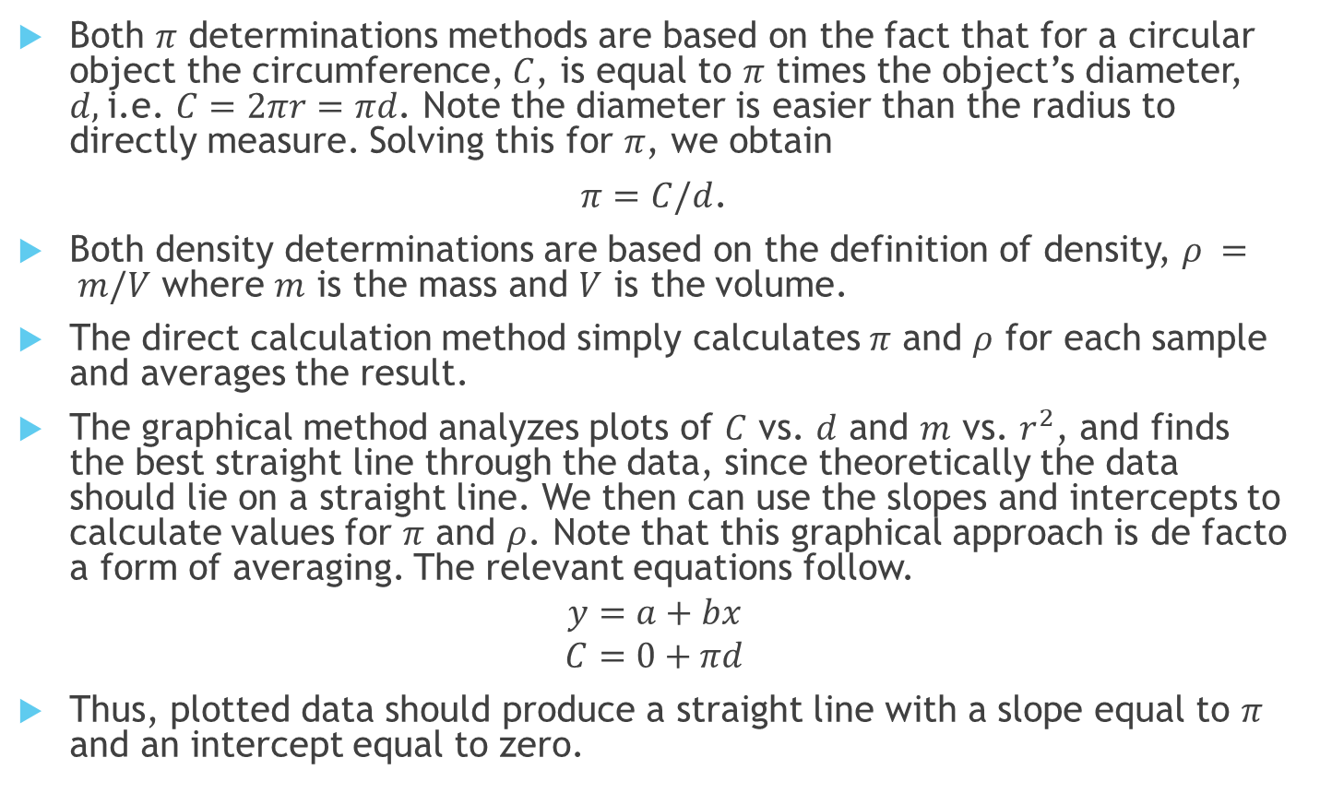
Introduction
Both $π$ determinations methods are based on the fact that for a circular object the circumference, $C$, is equal to $π$ times the object’s diameter, $d,$i.e. $C=2πr=πd$. Note the diameter is easier than the radius to directly measure. Solving this for $π$, we obtain
$π=C/d$.
Both density determinations are based on the definition of density, $ρ = m/V$ where $m$ is the mass and $V$ is the volume.
The direct calculation method simply calculates $π$ and $ρ$ for each sample and averages the result.
The graphical method analyzes plots of $C$ vs. $d$ and $m$ vs. $r^{2}$, and finds the best straight line through the data, since theoretically the data should lie on a straight line. We then can use the slopes and intercepts to calculate values for $π$ and $ρ$. Note that this graphical approach is de facto a form of averaging. The relevant equations follow.
$$y=a+bx$$
$$C=0+πd$$
Thus, plotted data should produce a straight line with a slope equal to $π$ and an intercept equal to zero.

Slide 3
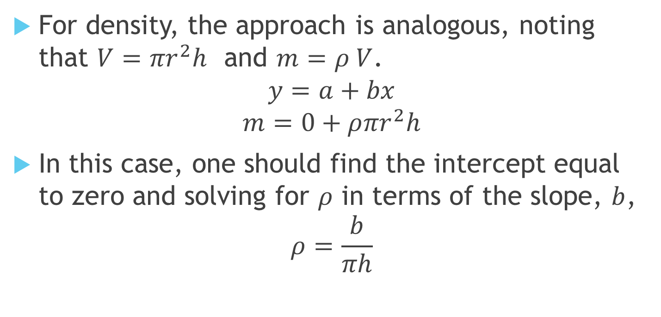
Introduction
For density, the approach is analogous, noting that ${V=πr}^{2}h$ and $m=ρ V$.
$$y=a+bx$$
$$m=0+ρ{πr}^{2}h$$
In this case, one should find the intercept equal to zero and solving for $ρ$ in terms of the slope, $b$,
$$ρ=\frac{b}{πh}$$

Slide 4
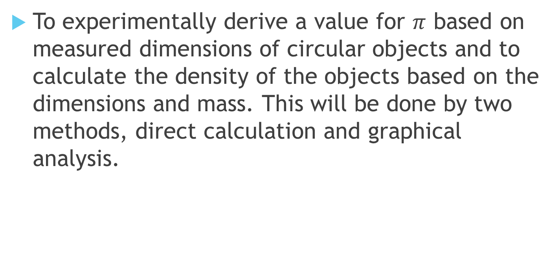
Objectives
To experimentally derive a value for $π$ based on measured dimensions of circular objects and to calculate the density of the objects based on the dimensions and mass. This will be done by two methods, direct calculation and graphical analysis.

Slide 5
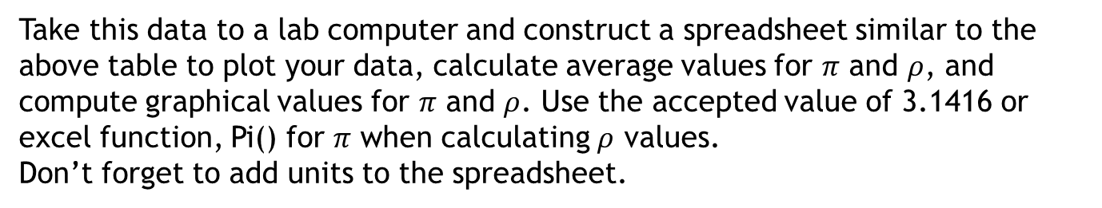
Procedure
1. Measure and record in the table below using the circumference, diameter, thickness, and mass of the 5 circular disks (right circular cylinders to be more precise), making sure you measure all the sizes and that you use SI/MKS units.
Disk | Circumference ( ) | Diameter ( ) | Thickness ( ) | Mass ( )
1
2
3
4
5
Take this data to a lab computer and construct a spreadsheet similar to the above table to plot your data, calculate average values for $π$ and $ρ$, and compute graphical values for $π$ and $ρ$. Use the accepted value of 3.1416 or excel function, Pi() for $π$ when calculating $ρ$ values.
Don’t forget to add units to the spreadsheet.
2. When you are satisfied, print one copy of the spreadsheet, write each lab partner’s name on it and submit it.

Slide 6
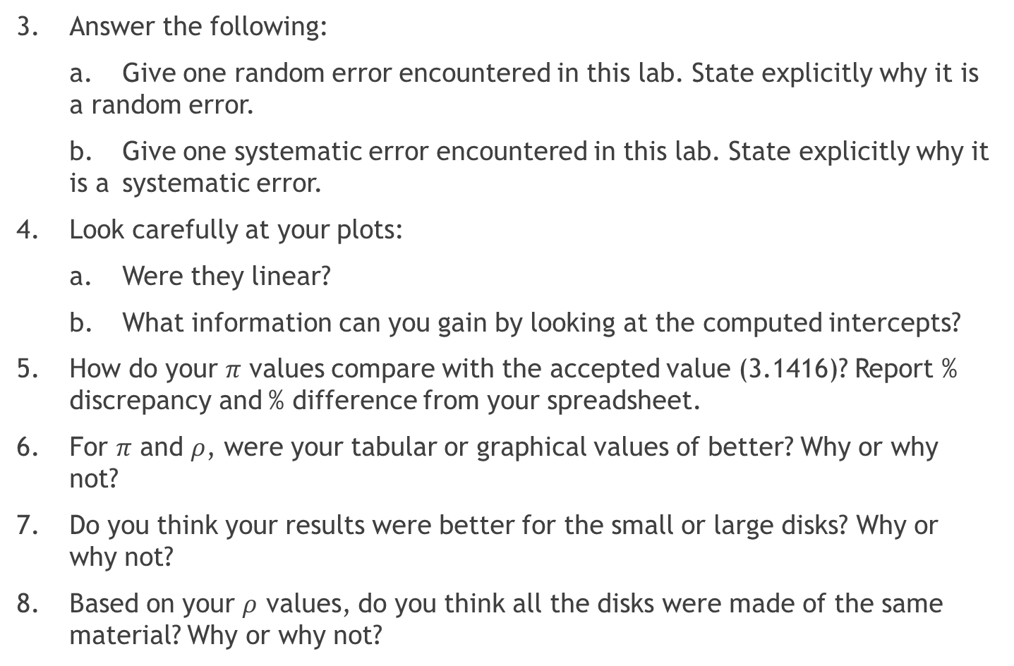
Analysis
3. Answer the following:
a. Give one random error encountered in this lab. State explicitly why it is a random error.
b. Give one systematic error encountered in this lab. State explicitly why it is a systematic error.
4. Look carefully at your plots:
a. Were they linear?
b. What information can you gain by looking at the computed intercepts?
5. How do your $π$ values compare with the accepted value (3.1416)? Report % discrepancy and % difference from your spreadsheet.
6. For $π$ and $ρ$, were your tabular or graphical values of better? Why or why not?
7. Do you think your results were better for the small or large disks? Why or why not?
8. Based on your $ρ$ values, do you think all the disks were made of the same material? Why or why not?

Slide 7
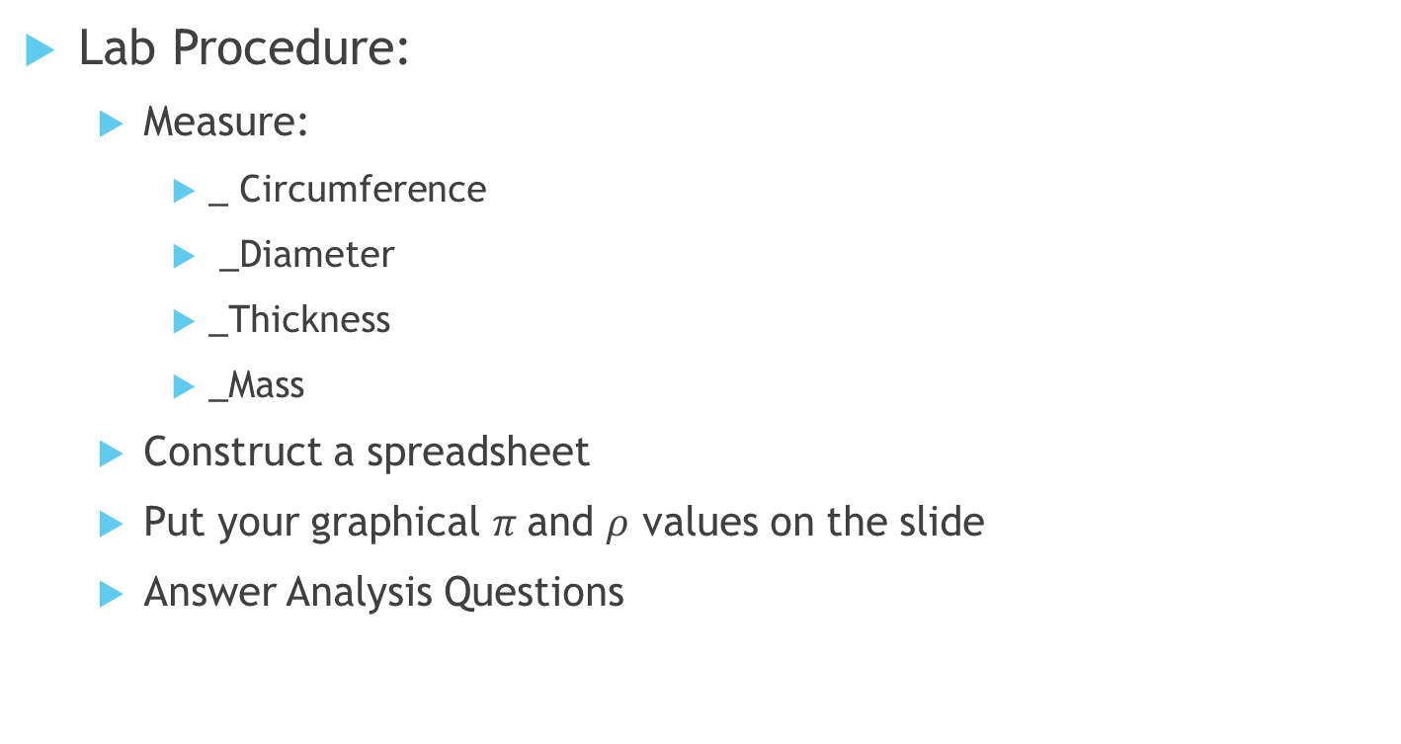
Summary
Lab Procedure:
  Measure:
    _ Circumference
    _Diameter
    _Thickness
    _Mass
  Construct a spreadsheet
  Put your graphical $π$and $ρ$ values on the slide
  Answer Analysis Questions

